Slide 1


Quantum Computing in Drug Discovery
Quantum computing revolutionizes drug discovery and development. By harnessing quantum mechanics, it offers unprecedented computational power. This technology promises to accelerate and enhance pharmaceutical research significantly.
by Krishna Thanmai Danda

Slide 2

Fundamentals of Quantum Computing
1
Qubits
Qubits exist in superposition, representing both 0 and 1 simultaneously. This allows for parallel processing of multiple states.
2
Entanglement
Quantum entanglement interconnects qubits, enabling instantaneous state changes across distances. This property enhances computational efficiency.
3
Quantum Interference
Interference manipulates qubit states, amplifying correct solutions and canceling incorrect ones. It's crucial for quantum algorithm optimization.

Slide 3
Benefits of Quantum Computing
Exponential Speed
Improved Efficiency
Quantum computers can solve certain problems exponentially faster than classical computers, revolutionizing fields like cryptography and drug discovery.
Quantum algorithms can optimize complex problems, reducing energy consumption and improving resource utilization in various industries.
Enhanced Modeling
Unbreakable Security
The unique properties of quantum systems enable more accurate modeling of complex phenomena, such as molecular interactions, leading to breakthroughs in fields like material science and pharmaceuticals.
Quantum computing can enable new forms of encryption that are virtually unbreakable, providing unprecedented data security and privacy protection.

Slide 4

Real-Time Applications in Drug Discovery and Development
Quantum computing offers promising advancements in drug discovery by improving the accuracy and efficiency of molecular simulations. Unlike classical computers, which struggle with simulating large, complex molecules, quantum computers can handle these tasks with greater precision. This could lead to faster, more targeted drug development processes.

Slide 5
Molecular Simulation Advancements
Classical Limitations
Quantum Advantage
Future Potential
Classical computers struggle with precise molecular simulations. They often produce approximations, limiting accuracy in drug design.
Quantum computers model electron interactions accurately. They can simulate complex molecules with unprecedented precision, enhancing drug efficacy predictions.
As quantum technology advances, simulations will become more sophisticated. This could lead to breakthroughs in treating complex diseases.

Slide 6
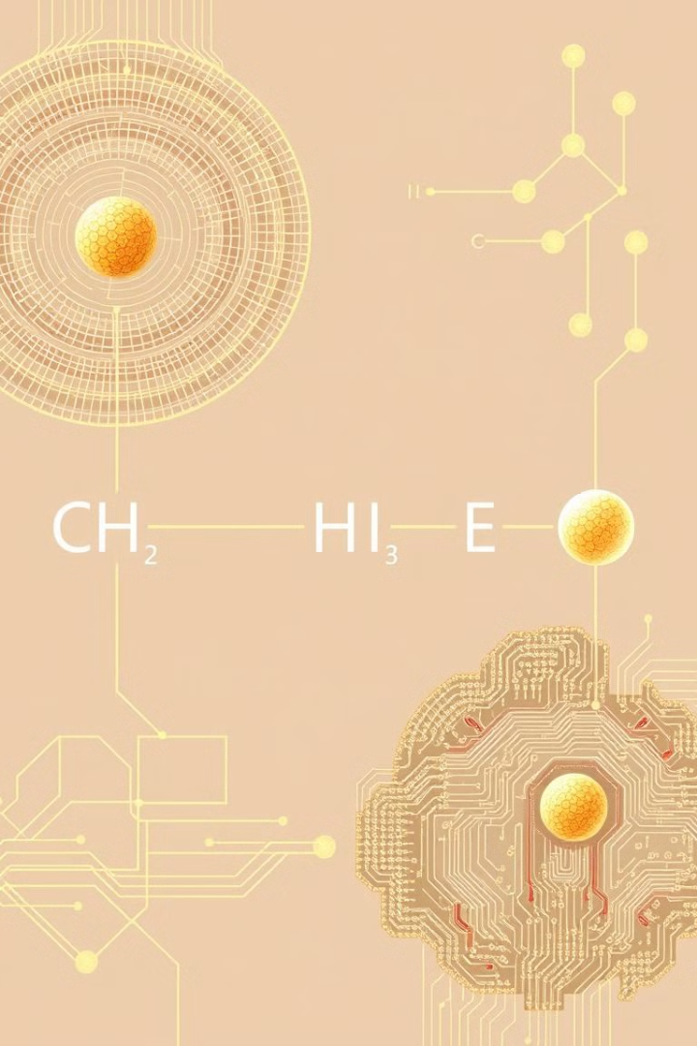
Optimization of Chemical Reactions
1
Reaction Pathway Analysis
Quantum algorithms identify optimal reaction pathways. They consider multiple variables simultaneously, improving synthesis efficiency.
2
Catalyst Design
Quantum simulations enhance catalyst design. They predict catalyst performance, reducing experimental trial-and-error.
3
Green Chemistry
Optimized processes reduce waste and energy consumption. This leads to more environmentally friendly drug production methods.

Slide 7

Personalized Medicine Approach
Genetic Analysis
Quantum computers process complex genomic data rapidly. They identify genetic markers associated with drug responses more efficiently.
Drug-Patient Matching
Advanced algorithms predict drug efficacy for individual patients. This enables tailored treatment plans based on genetic profiles.
Side Effect Prediction
Quantum simulations forecast potential side effects. They consider patient-specific factors, enhancing treatment safety.

Slide 8
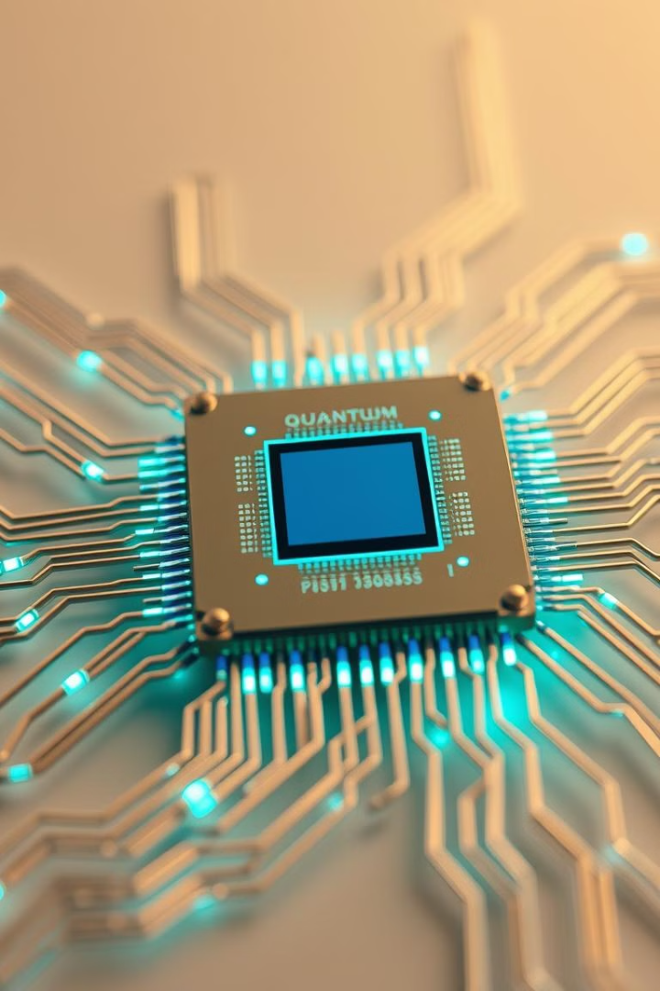



Quantum-Classical Hybrid Approaches
Data Preparation
Classical systems preprocess and format data. They prepare input for quantum algorithms efficiently.
Quantum Processing
Quantum computers perform complex calculations. They tackle the most computationally intensive tasks in drug discovery.
Result Interpretation
Classical systems analyze and interpret quantum outputs. They translate results into actionable insights for researchers.

Slide 9

Challenges in Quantum Drug Discovery
Challenge
Impact
Potential Solution
Quantum Decoherence
Limits computation time
Advanced error correction techniques
Scalability
Restricts problem size
Improved qubit architecture
Algorithm Development
Slows adoption
Collaborative research initiatives

Slide 10




Current Applications in Pharma
Structure Analysis
Quantum algorithms analyze complex molecular structures. They identify potential drug candidates more efficiently than classical methods.
Genomic Processing
Quantum computing accelerates genomic data analysis. It enables faster identification of genetic markers for targeted therapies.
Clinical Trial Optimization
Quantum-inspired algorithms optimize clinical trial designs. They improve patient selection and reduce trial durations.

Slide 11
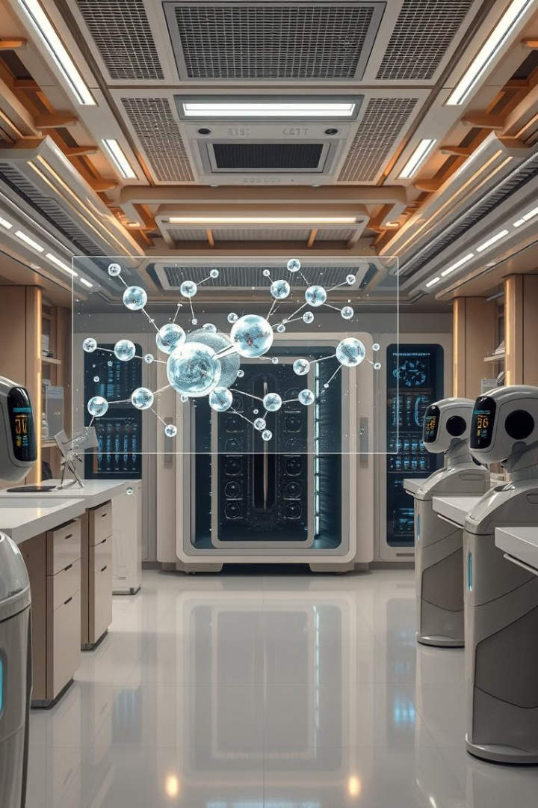
Future Prospects in Drug Discovery
1
2025: Enhanced Simulations
Quantum computers will simulate larger molecular systems. This will accelerate early-stage drug discovery significantly.
2
2030: AI Integration
Quantum-AI hybrid systems will revolutionize drug design. They'll predict drug efficacy with unprecedented accuracy.
3
2035: Personalized Medicine
Quantum computing will enable truly personalized treatment plans. It'll consider individual genetic profiles in real-time.

Slide 12

Preparing for the Quantum Era
1
Skill Development
Pharmaceutical companies must invest in quantum computing training. Researchers need to understand quantum algorithms and their applications.
2
Infrastructure Investment
Organizations should prepare for quantum-ready infrastructure. This includes both hardware and software adaptations.
3
Collaborative Research
Partnerships between pharma, tech companies, and academia are crucial. They will drive innovation in quantum drug discovery.

Slide 13
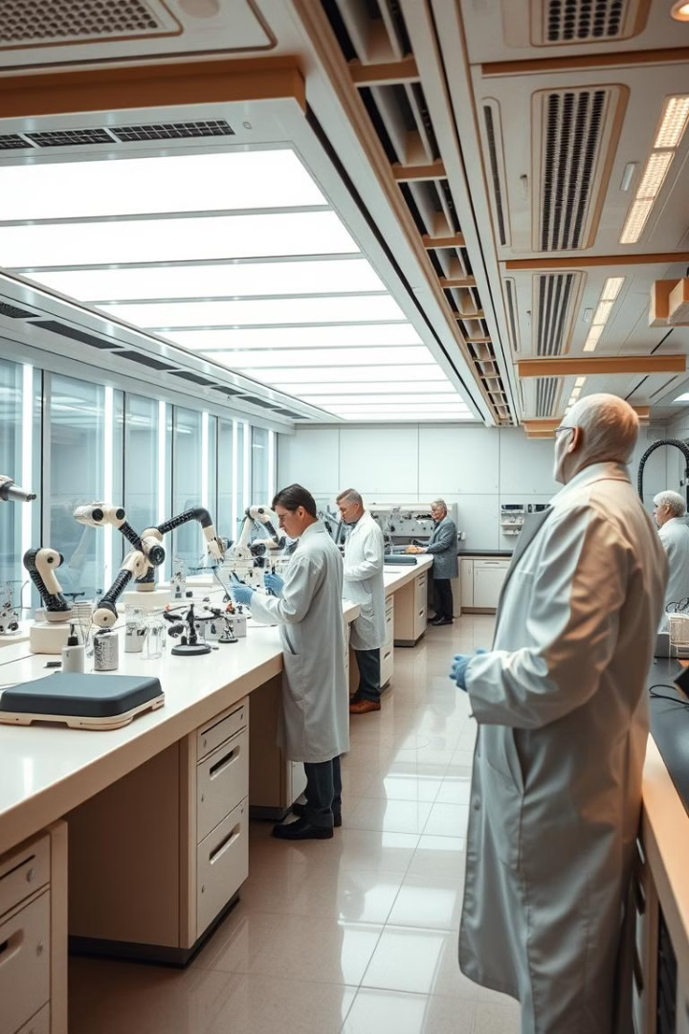
Conclusion
Quantum computing revolutionizes drug discovery.
Hybrid quantum-classical systems accelerate pharmaceutical R&D.
Pharmaceutical organizations must invest in quantum computing skills, infrastructure, and research.
Quantum computing will design highly effective, customized drugs, revolutionizing medicine.
Pharmaceutical leaders will gain a competitive edge by adopting quantum computing.

